Slide 1
Lecture 1
ELECTRICAL SCIENCE-1
15B11EC111
Introduction
Course outcomes
Syllabus
Evaluation criteria

Slide 2
Pre-requisites: Fundamental physics, Calculus, Complex Variables
Course credits: 4
Semester: 2
Course Focus: Foundations of Electronics

Slide 3
COURSE OUTCOMES |  | COGNITIVE LEVELS
C113.1. | Recall the concepts of voltage, current, power and energy for different circuit elements. Apply the Kirchhoff laws and different analyzing techniques to identify the different circuit parameters. | Applying (Level III)
C113.2. | Define and apply the networks theorems in the complex AC and DC circuits, networks. Demonstrate the physical model for given Sinusoidal AC signal and construct the phasor diagrams. | Applying (Level III)
C113.3. | Demonstrate the concept of resonance and operate different instrumental and measurement equipments. | Understanding (Level II)
C113.4. | Demonstrate the construction and working of single phase transformer | Understanding (Level II)

Slide 4
COURSE OUTLINE
Module No. | Title of the Module | Topics in the Module | No. of Lectures for the module
1. | Basic Concepts | Voltage, Current, Power and Energy analysis for Circuit elements (R, L, C), Independent and Dependent Sources, Kirchhoff's Laws, Voltage Divider rule, Current Divider rule | 6
2. | DC Circuit Analysis | Star-Delta Transformation, Source transformation, Mesh and Supermesh Analysis, Nodal and super nodal Analysis | 6
3. | Network Theorems | Superposition Theorem, Thevenin’s Theorem, Norton’s Theorem, Maximum Power Transfer Theorem | 6
4. | Sinusoidal Steady State Analysis | Physical Model for a Sinusoid, Average Value, Effective Value, Phasor presentation, Addition of Phasor using Complex Numbers, Concepts of impedance and admittance. | 4
5. | AC Network Analysis and Theorems | Mesh and Nodal analysis, Superposition Theorem, Thevenin’s Theorem, Norton’s Theorem, Maximum Power Transfer Theorem | 6
6. | Resonant Circuits | Series and Parallel resonance, frequency response of Series and Parallel resonance, Q-Factor, Bandwidth | 4
7. | Electrical Instruments | Essentials of an Instrument, Permanent Magnet Moving Coil (PMMC) Instruments, voltmeter, ammeter, Ohmmeter, Meter Sensitivity (Ohms-Per-Volt Rating); Loading Effect; Multimeter; Cathode Ray Oscilloscope: Construction, | 6

Slide 5
 |  | Working and Applications. Function Generators
8. | Single Phase Transformer | Principle of operation, construction, e.m.f. equation, equivalent circuit, power losses, efficiency (simple numerical problems), introduction to auto transformer. | 4
Total number of Lectures |  |  | 42

Slide 6
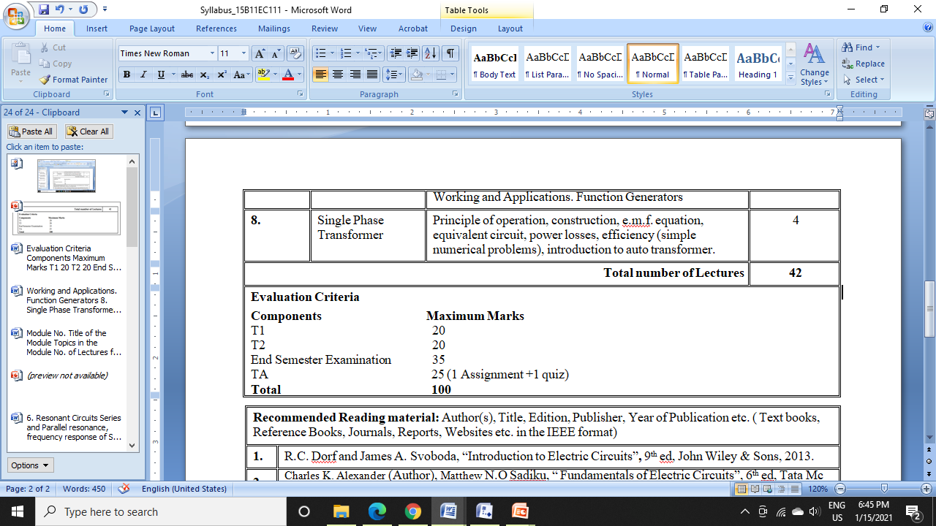
EVALUATION CRITERIA

Slide 7
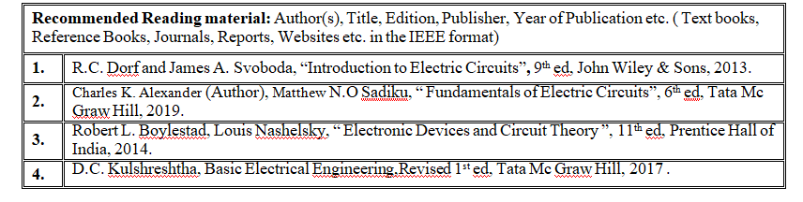
RECOMMENDED BOOKS:

